Slide 1
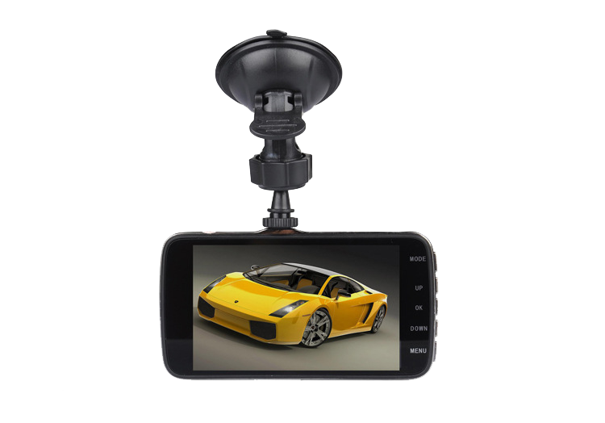
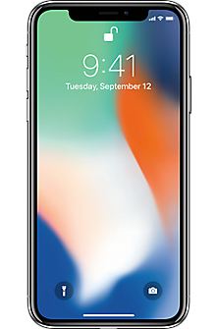
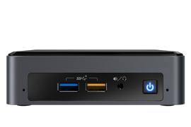
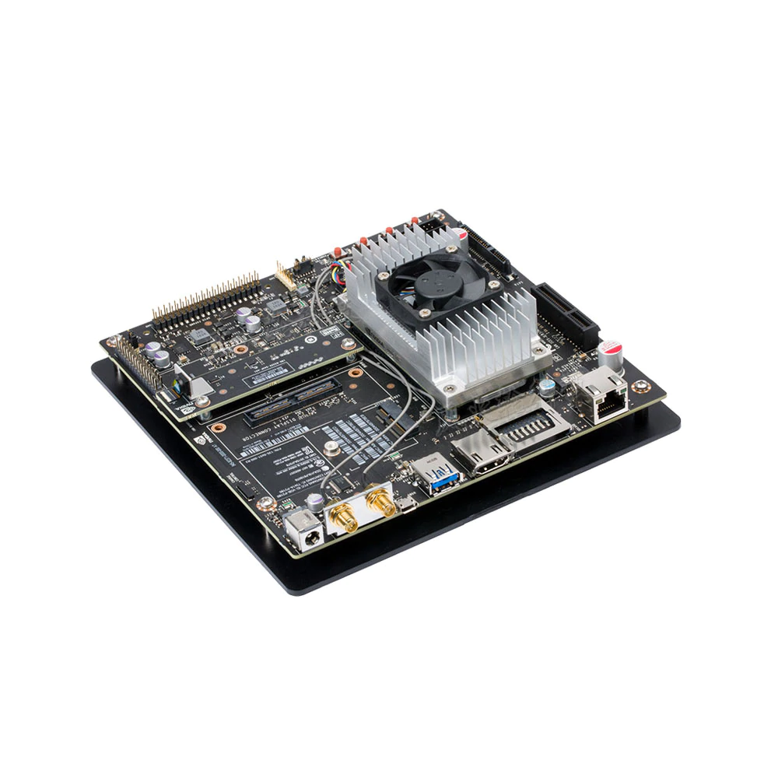
Basic Information:
Project ID: sddec20-11 | Name: Sparrow
Team Members: Evan Timmons, Cobi Mom, Danny Yip, Scott Vlasic, Durga Darba, Ismael Duran
Faculty Adviser: Joseph Zambreno | Client: Evan Timmons
Introduction/Motivation: (concise and to the point...)
Around 2 million drivers in car accidents experience permanent injuries every year. We hope to reduce that number with Sparrow, a product designed to automatically scan license plates and report reckless drivers when they are encountered instantly.
Design Requirements:
Functional requirements - license plate reader
Non-functional requirements-user can always watch their videos from mobile application
Operating environment- mounted on windshield, able to handle fluctuation temperature.
Intended users and uses
Design Approach:
App Requests
App Requests
Cloud Upload
Cloud Download
Dash Camera
Mini PC
Phone Application
Record Video
Record Request
Footage Review
Local License Plate Lookup
Cloud License Plate Lookup
All other requests
Stream
Save Raw Backup
Return Request
System Control
Analyze Video
Perform ML Lookup
Annotate File
ML System
Save Backup
Save Annotated Backup
Save Backup
Technical Details:
AWS Lambdas were used in integration with API Gateway, DyanamoDB, and S3
OpenALPR and FFMPEG was used to handle videos on the board and get license plate data
Testing
Flutter library (flutter_test) was used to assist with unit testing
Develop unit test to test functionality of the mobile application
Test instantaneous of API successes and failures
System testing via the NVIDIA Jetson TX2
Testing by hand to determine the accuracy of OpenALPR license plate detection rates
Testing in the vehicle environment to ensure power is being supplied and functionality is performing as expected
Notes:
Testing environment
Testing strategy (unit testing, system testing, etc.)

Slide 2
